Slide 1
My life in fast forward
A presentation by luka sanikidze

Slide 2
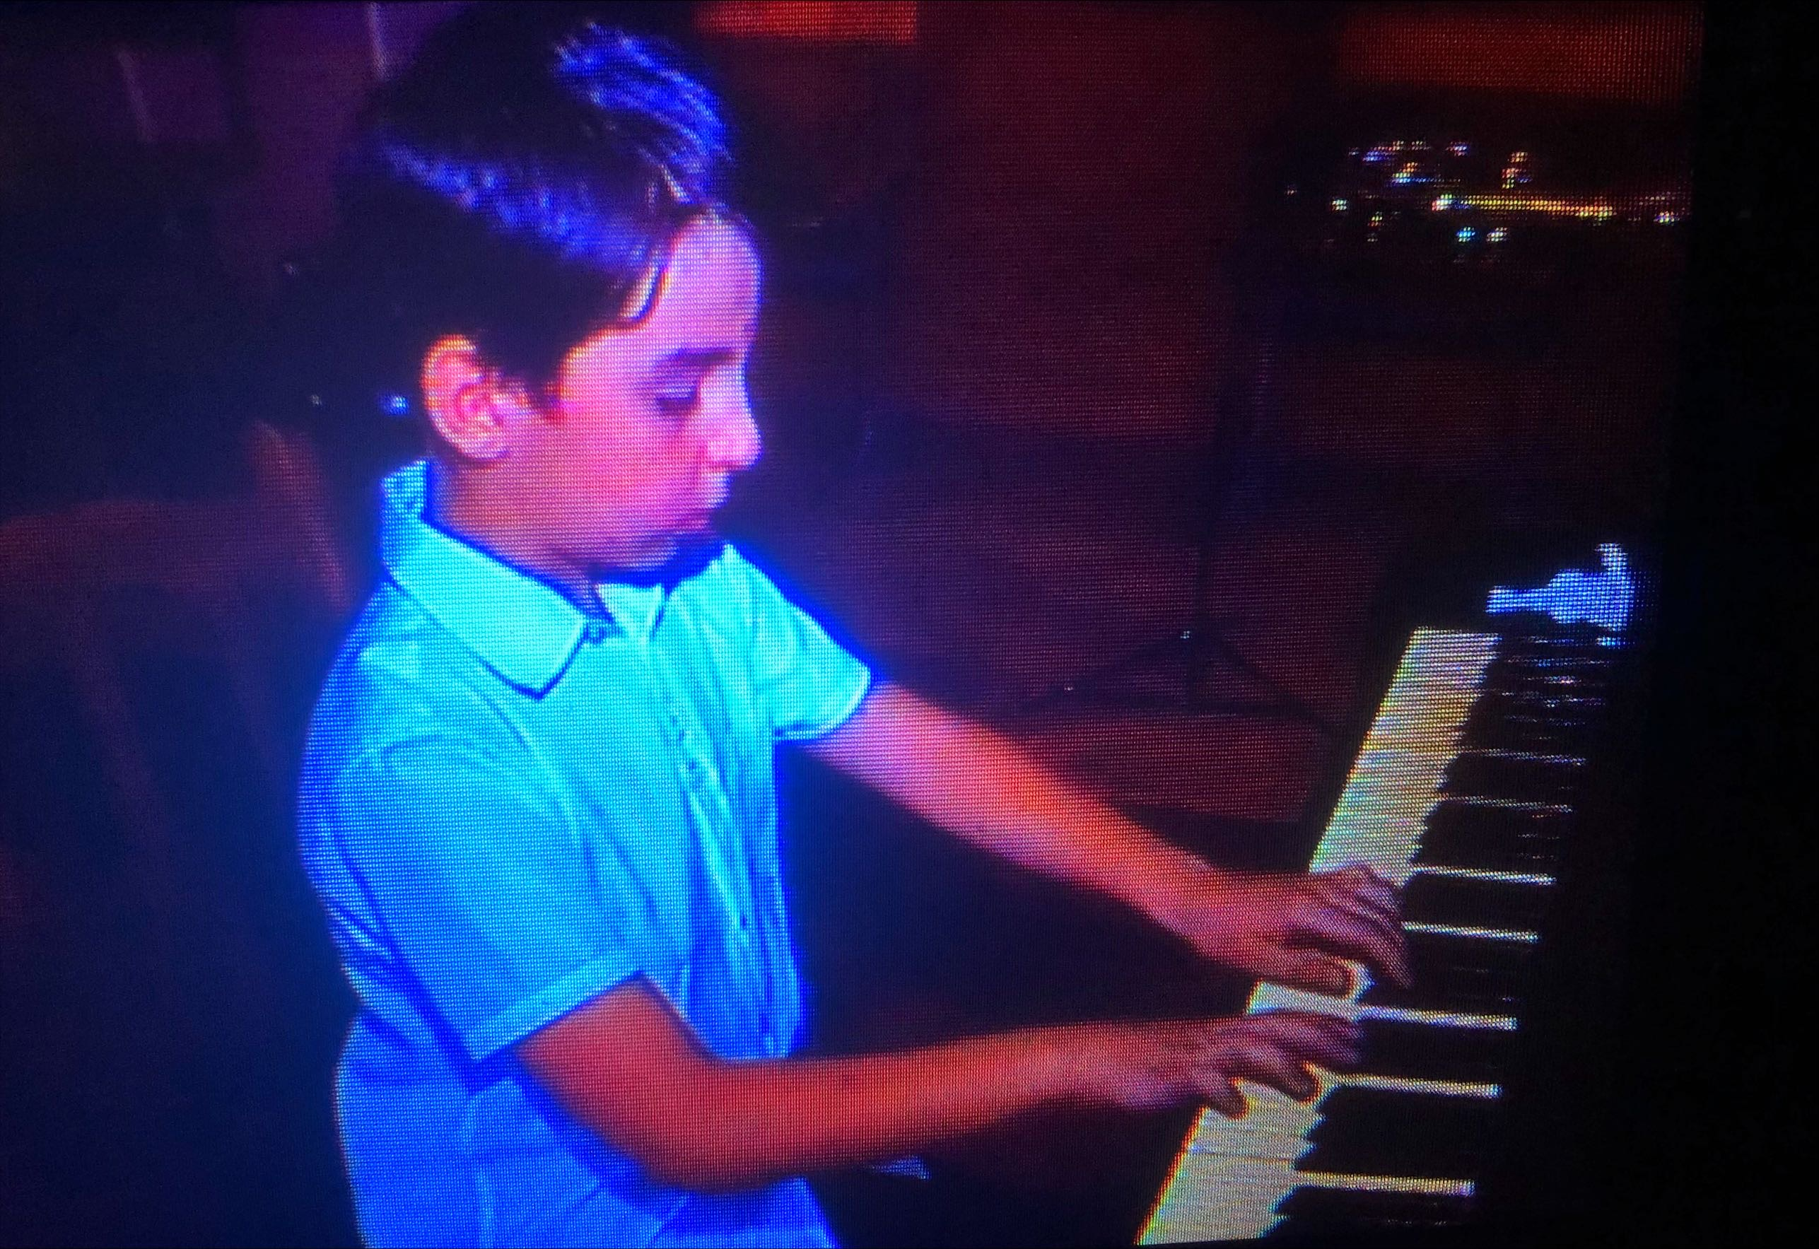
Childhood
Becoming interested in science
Becoming interested in music

Slide 3
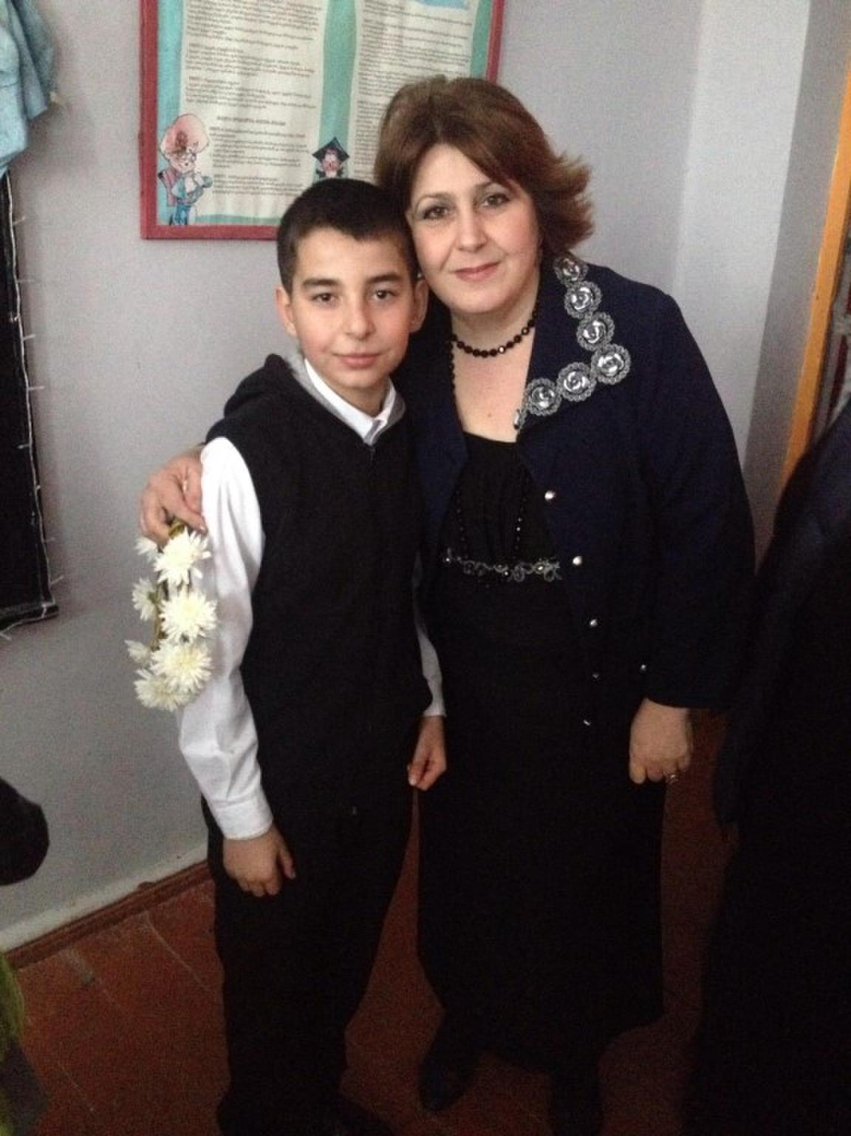
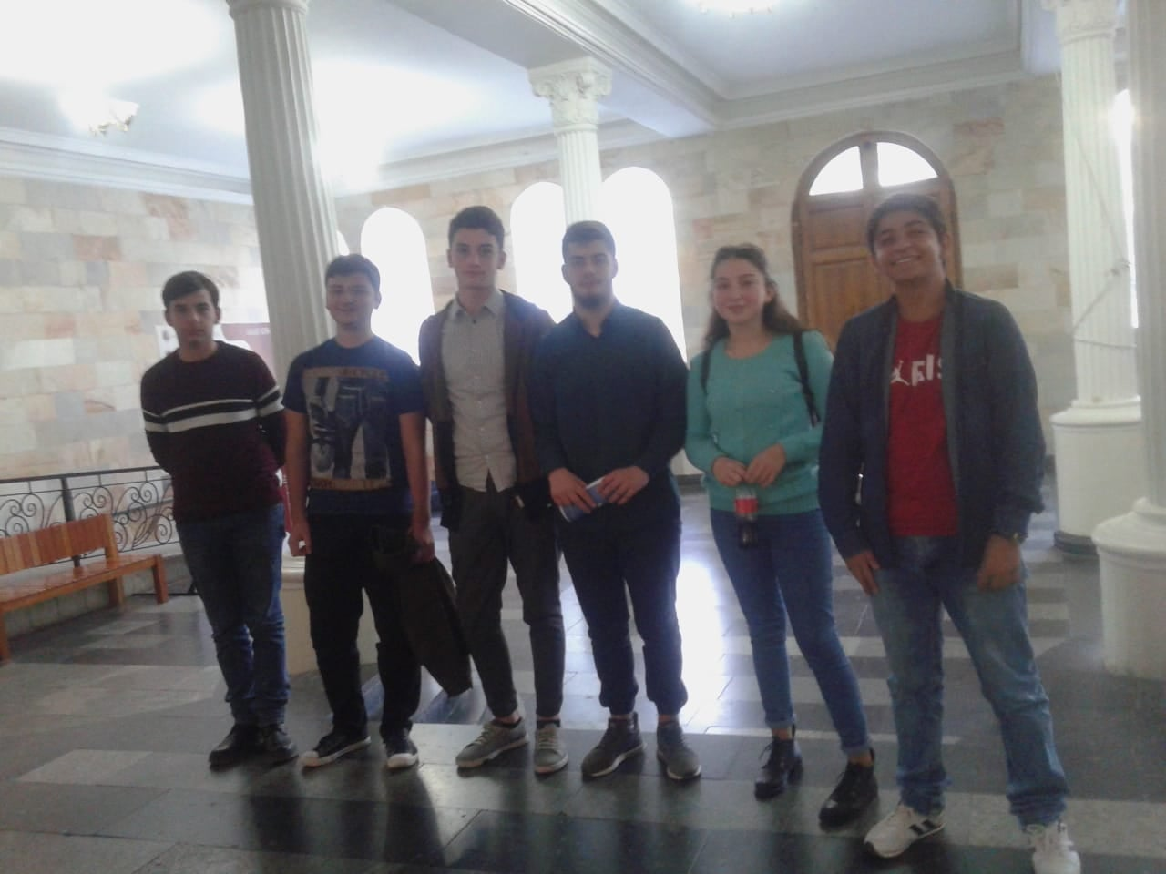
Adolescence
Acting in a play
Participating in various quizzing competitions

Slide 4
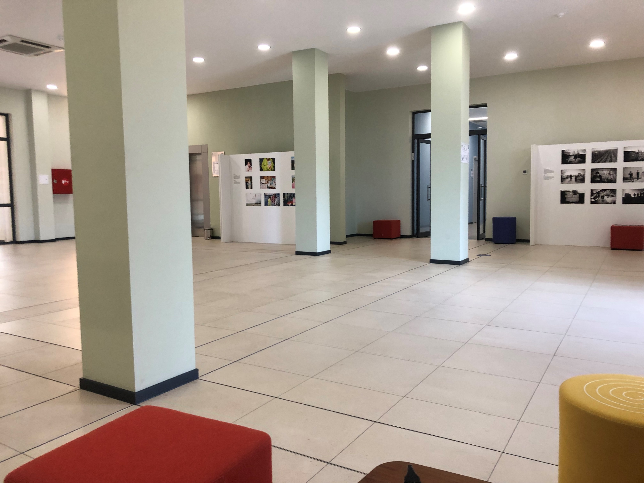
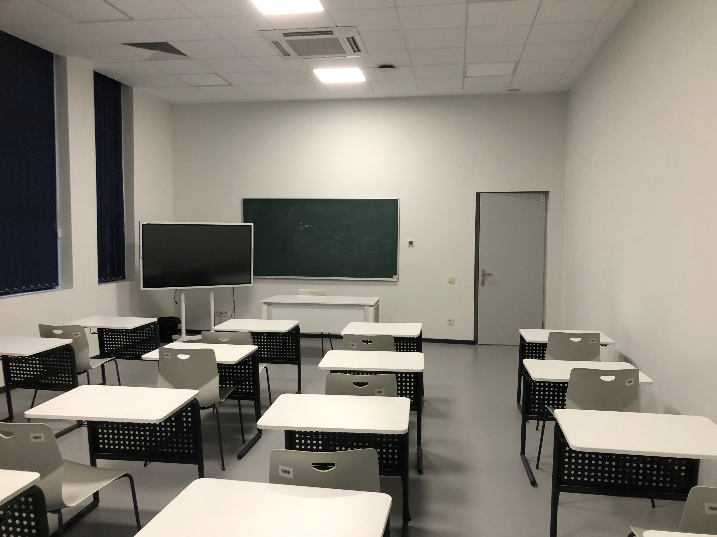
Studying at KIU
Reevaluating the goals and getting a more realistic outlook

Slide 5
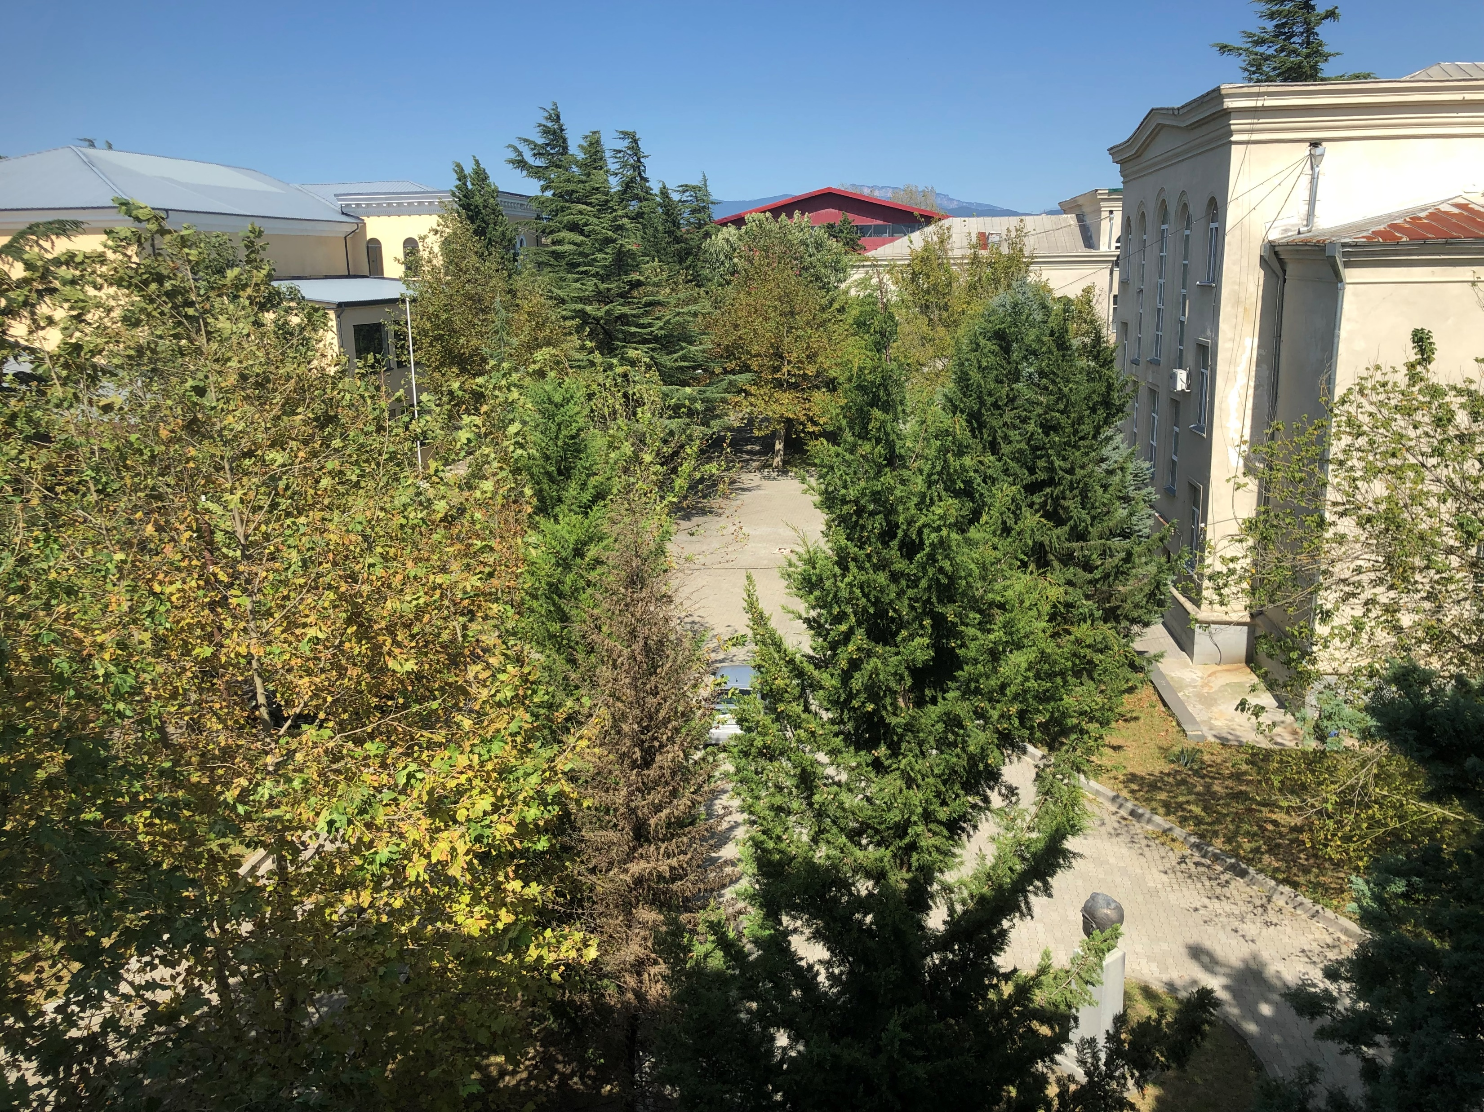
Finding Peace and Stability
Starting everything from scratch with an experience and realistic goals

